Slide 1


Security Principle 5: Access Control
Controlling who can access what in the digital world

Slide 2
What is Access Control?
Access Control: making sure that only authorised users are the ones who can access data or services (National Cyber Security Centre - NCSC.GOV.UK, 2026).

Slide 3
Why does Access Control matter?
Access control matters because it is the methods that define how only authorised users can access the organisation’s information.
Access control helps ensure that only authorised users can view, modify or share resources, preventing unauthorised access which maintains data integrity.
  Incorrect access permissions remain a common cause of data exposure - misconfiguration accounted for 21% of error-related breaches. (Verizon, 2024).
  This shows that weak access restrictions can increase the likelihood of unauthorised access and security breaches.
Access control works closely with privilege management, as they both help ensure only authorised users access the resources they necessarily need.
Let's see what happens when access control fails in Ubuntu and AWS, and how to fix it.

Slide 4
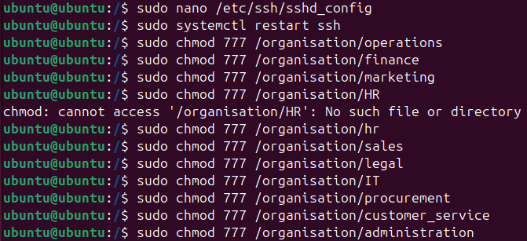
Initial Linux Vulnerable Setup
sudo chmod 777 – “chmod” command determines the access permissions of files and directories
  1st digit represents the owner’s current permission
  2nd digit represents the group’s current permission
  3rd digit represents everyone else’s current permission
  The number “7” means the party can read, write and execute the file. (Linuxize, 2020)
It makes for the owners and the group to be able to access the files freely, but not everyone else……
Figure 1: Folders in “organisation” being set to read, write and execute for the owner, group and everyone else
Figure 2: All files and folders of “organisation” being set to write and execute for the owner, group and everyone else

Slide 5
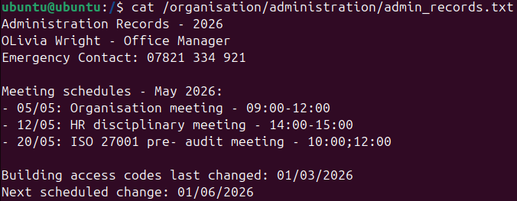
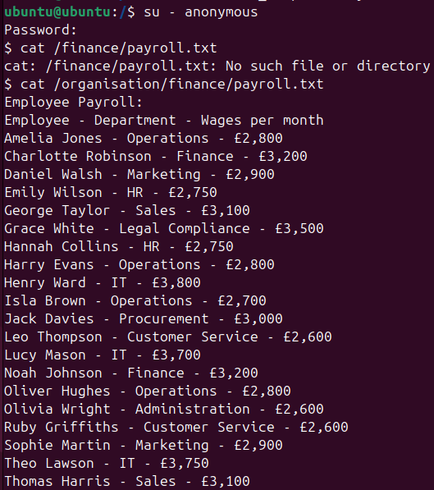
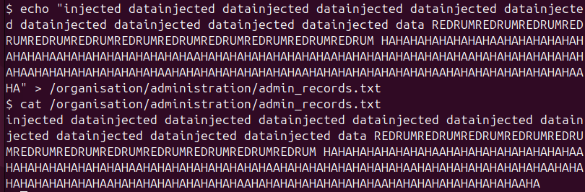
Linux Exploitation Process
admin_records.txt is a file within the Administration folder of the business. The file stores records of the business’s upcoming and current operations.
To alter the contents of the text file, I created the user “anonymous”, and used the echo “” > command, spamming random words together.
In a real-world scenario, an account having access to a file path and its contents requires a lot more steps, but open permissions = data exposure.
The attack is accomplished as shown in Figure 5, when they use the cat command to show the new contents of admin_records.txt.
Figure 3: Initial content of “admin_records.txt”
Figure 4: An external “anonymous” user changes replace the contents of “admin_records.txt”
Figure 5: New content of “admin_records.txt” as a result of the attack from “anonymous

Slide 6
Why did the exploitation work?
The exploitation worked because chmod 777 gives read, write and execute permissions to everyone; the owners and the group who are part of the organisation, and also others, including non-members of the business.
This means any user on the system or anyone who has gained access can freely do anything with the files and folders, such as viewing, modifying, obtaining, exposing and deleting data.
This vulnerability compromises the confidentiality, integrity and availability of the data (Nepal, 2013).
This highlights how important it is to restrict access to sensitive information, as the public should not know confidential data in relation to the business’s private operations.
The business should limit the viewing of its data to themselves only, as they are the authorised ones, but failed to do so by not reviewing the privileges correctly and periodically to ensure the confidentiality of data.

Slide 7
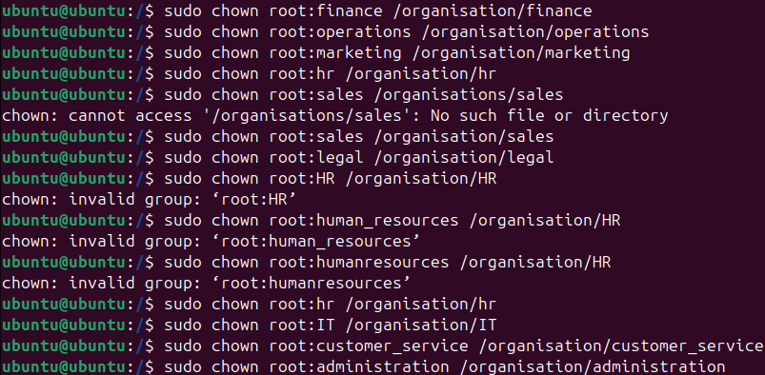
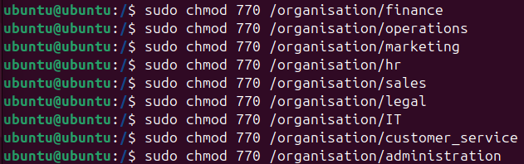
Solutions for preventing exploitation: Enforcing access control policies in Ubuntu
Assigning ownership – Using the “sudo chown root” command, each department is declared as the owner of the file path of its corresponding department folder. They now own the data that is in relation to their work and operations.
Chmod 777 to 770 – Each folder now has 770, which means you can’t access the department folders unless you work in the department yourself.
  This can cause a problem if someone within another department of the business needs access to data. Carefully consider the request by referring to the approval rules that govern access to your own systems (www.ncsc.gov.uk, n.d.).
Figure 6: All files and folders of “organisation” being set to write and execute for the owner, group and everyone else
Figure 7: All files and folders of “organisation” being set to write and execute for the owner, group and everyone else

Slide 8
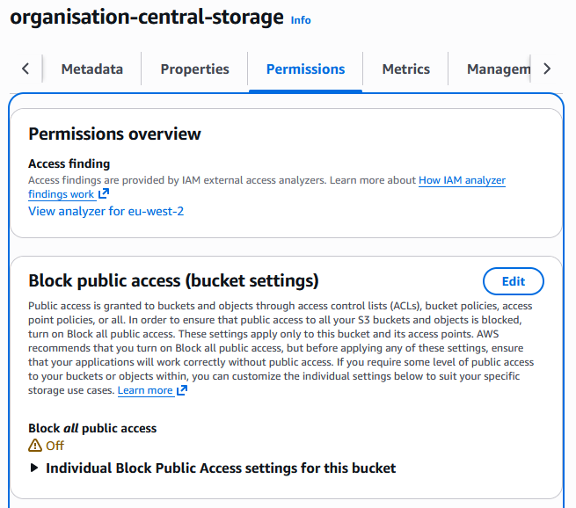
Initial AWS Vulnerable Setup
AWS S3 buckets: “storage service that offers data availability, security and performance”. Users of the cloud service use it to store any amount of data (AWS, 2023).
The business has an S3 bucket named “organisation-central-storage” where it stores its data in files and folders.
It is the centre of the business’s activities because the folders are named after the departments, and each folder has files in relation to their operations.
However, just like Ubuntu, the S3 Bucket has public access because Block public access in AWS wasn’t configured.
This allows unrestricted public access to users who can identify the bucket, allowing them to read, list and upload objects. This leaves data exposed with no authentication required.
Figure 6: “organisation-central-storage” S3 bucket of the organisation having public access on

Slide 9
{
"Version": "2012-10-17",
"Statement": [
{
"Sid": "AllowPublicRead",
"Effect": "Allow",
"Principal": "*",
"Action": "s3:GetObject",
"Resource": "arn:aws:s3:::organisation-central-storage/*"
},
{
"Sid": "AllowListBucket",
"Effect": "Allow",
"Principal": "*",
"Action": "s3:ListBucket",
"Resource": "arn:aws:s3:::organisation-central-storage"
},
{
"Sid": "AllowReadWriteObjects",
"Effect": "Allow",
"Principal": "*",
"Action": [
"s3:GetObject",
"s3:PutObject"
],
"Resource": "arn:aws:s3:::organisation-central-storage/*"
}
]
}
The S3 Bucket vulnerability is further increased by a bucket policy that uses “Principal”: “*”.
This JSON command specifies who the policy applies to, and “*” means anyone, including the public (docs.aws.amazon.com, n.d.). AWS strongly recommends not to use “Principal” like this
Figure 7: Bucket Policy Implemented

Slide 10
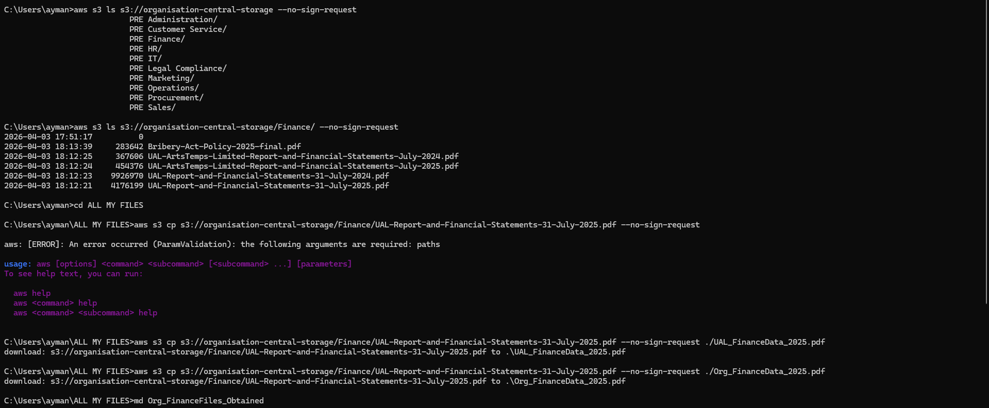
How can S3 Buckets be obtained??
The hacker used the command centre to search for the S3 bucket using the bucket path and command --no-sign-request.
The command was used to access the public bucket, as it prevents credentials from being loaded (no verification of the user trying to access). (Amazon.com, 2026)
--no-sign-request was used with --recursive and a newly created folder, in which the files of the organisation in the bucket will be downloaded (NetworkChuck, 2023).
The attacker has now downloaded confidential reports, policy documents and financial records that reveal sensitive business data.
Figure 8: Viewing and downloading contents of the S3 bucket through the Command Prompt
* File Path blurred out to avoid showing personal identifiers

Slide 11
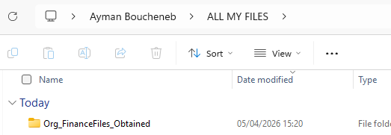
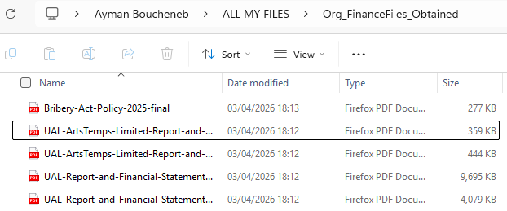
Figures 9 and 10: Proof of files being downloaded from the Command Prompt
*UAL PDF files being used as examples for this fictional simulation

Slide 12
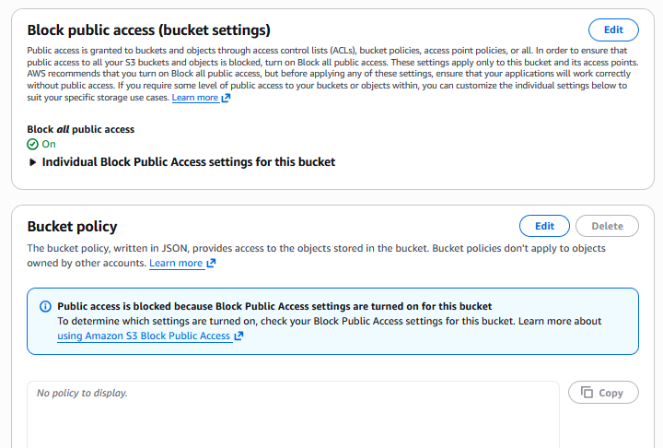
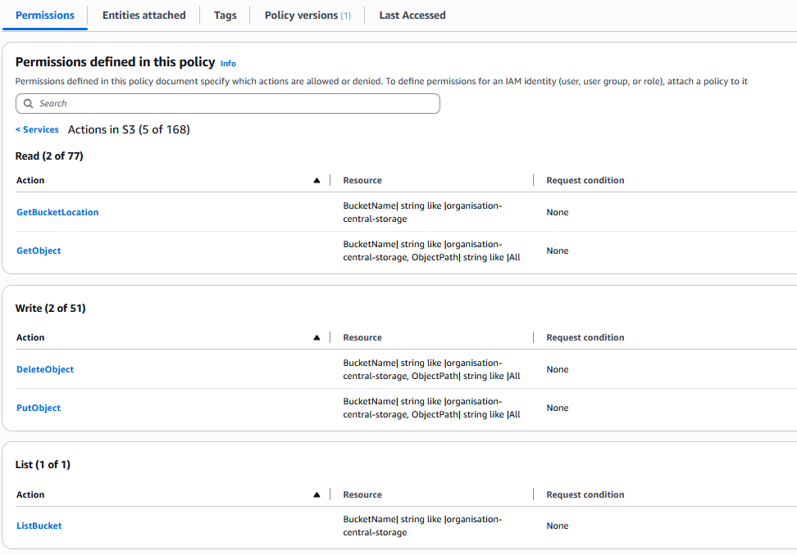
Solutions for reducing risk: Enforcing access control policies in AWS
Enable Block public access & Remove the bucket policy: ensures that the S3 Bucket is a centralised control for the business only. Access is only restricted to members of the organisation, as they have permissible access to their system. No longer allows public access, meaning no unauthorised access from members of the public (docs.aws.amazon.com, n.d.).
A new IAM policy was created to control access to the organisation’s S3 bucket by defining what actions authorised users were allowed to perform and assigned to each employee.
It replaces the previous unrestricted public access with restricted permissions for the employees, ensuring only they can access, upload and delete files.
Figures 11 & 12: Block Access being enabled and Permissions being set for authorised employees

Slide 13
Solutions for preventing exploitation
As both simulations have uncovered how public access leaves data vulnerable for both systems, the security procedures that have to be implemented are similar.
They are similar to the ones in privilege management as they both help ensure only authorised users access the resources they necessarily need.
Periodic Reviews of assigned user privileges for each employee to determine if they have the necessary amount to perform their respective operations (Joint Task Force, 2020).
Test access using user accounts to verify that permissions match job responsibilities and authorised access.
NCSC guidance (Ncsc.gov.uk, 2024):
  All user and device access to the system is logged and monitored. Review the access logs regularly and correlate them to data activities.
  Investigate and properly assess any attempts by unauthorised users or devices to connect to the system, to identify how it has occurred and mitigate the access point.

Slide 14
Summary
Access Control is making sure that only authorised users are the ones who can access data or services.
Because it ensures only authorised access, it prevents data modification, deletion and protects its confidentiality, which maintains data integrity.
In both Ubuntu and AWS, we discovered that enabling public access leaves the data open to anyone outside the organisation. This carries the risk of confidential data being obtained, modified or accessed.
To prevent this, disable any enabled public access to the data
Ensure that only employees are the ones who have the authorisation to access the business’s data. Follow that up by giving the right amount of privileges that is enough for them to perform their own roles. This should be reviewed periodically.
Monitor activity logs and investigate any unauthorised attempts at accessing data.

Slide 15
References
National Cyber Security Centre - NCSC.GOV.UK. (2026). Access control. [online] Available at: https://www.ncsc.gov.uk/section/advice-guidance/all-topics/access-control.
Verizon (2024). 2024 Data Breach Investigations Report. [online] Verizon Enterprise Solutions. Available at: https://www.verizon.com/business/resources/reports/2024-dbir-data-breach-investigations-report.pdf.
www.ncsc.gov.uk. (n.d.). Use privileged access management. [online] Available at: https://www.ncsc.gov.uk/collection/secure-system-administration/use-privileged-access-management.
Linuxize (2020). What Does chmod 777 Mean. [online] Linuxize.com. Available at: https://linuxize.com/post/what-does-chmod-777-mean/.
Nepal, A.K. (2013). Linux Server & Hardening Security. [online] doi:https://doi.org/10.13140/2.1.5079.2329.
AWS (2023). What is Amazon S3? - Amazon Simple Storage Service. [online] docs.aws.amazon.com. Available at: https://docs.aws.amazon.com/AmazonS3/latest/userguide/Welcome.html.
docs.aws.amazon.com. (n.d.). AWS JSON policy elements: Principal - AWS Identity and Access Management. [online] Available at: https://docs.aws.amazon.com/IAM/latest/UserGuide/reference_policies_elements_principal.html.

Slide 16
References
Amazon.com. (2026). Command line options in the AWS CLI - AWS Command Line Interface. [online] Available at: https://docs.aws.amazon.com/cli/v1/userguide/cli-configure-options.html
NetworkChuck (2023). intro to cloud hacking (leaky buckets). [online] YouTube. Available at: https://www.youtube.com/watch?v=0kk6k-VdllM.
docs.aws.amazon.com. (n.d.). Blocking public access to your Amazon S3 storage - Amazon Simple Storage Service. [online] Available at: https://docs.aws.amazon.com/AmazonS3/latest/userguide/access-control-block-public-access.html.
Joint Task Force (2020). Security and Privacy Controls for Information Systems and Organizations. Security and Privacy Controls for Information Systems and Organizations, [online] 5(5). doi:https://doi.org/10.6028/nist.sp.800-53r5.
Ncsc.gov.uk. (2024). Principle B2 Identity and Access Control. [online] Available at: https://www.ncsc.gov.uk/collection/cyber-assessment-framework/caf-objective-b/principle-b2-identity-and-access-control.

